Slide 1


LEARNING
MATE
Learning
Management
System

Slide 2


INDEX
Learning Management System
Introduction and Roles
Planning and Purpose
Development Technical Stack
UX·UI Wireframes and Storyboard
Relational Data Modeling
Core Sources
1
2
3
4
5
6

Slide 3



Learning Management System
Introduction and Roles

Slide 4







Learning Management System
INTRODUCTION AND ROLES
프론트엔드
신준철
오연주
김태영
팀장
Front-end 총괄
강사, 훈련생 관련 모든페이지 디자인 및 코딩 (List + CRUD기능)
Front-end와 Back-end 연동을 위한 요청코드 및 return 데이터 가공코드를 작성하여 화면에 출력
리액트 프로그램 활용한 LMS 프로그램 과정 조회, 등록 페이지 컴포넌트 제작 및 구현
CSS 기능을 바탕으로 한 프로그램 디자인 설계 및 제작
백엔드에서 보내주는 CRUD 데이터와 프론트 화면의 연동 구현
과정 상세 조회 페이지 설계 및 디자인

Slide 5
Learning Management System
Planning and Purposes

Slide 6



Learning Management System
PLANNING PURPOSE
세상에서
가장 쉬운
학습 관리 시스템
직관적인 구성
사용자가 빠르게 적응할 수 있는 시스템 구축
편리한 기능
최소한의 조작으로 기능 구현
효율적 운영
핵심기능에 집중하여 생산성 극대화
편리성
간소화
Convenience
Simplification
자동화
효율성
Automation
Efficiency

Slide 7
Learning Management System
Development Technical Stack

Slide 8







Learning Management System
Development Technical Stack
01. Package Management Tool
- scoop chore(release):
Bump to version 0.5.2 (#6080)
02. IDE (Integrated Development Environment)
- Eclipse for enterprise edition,
version 2025-03 with Spring Tools version 4.29.0 RELE
- MS Visual Source Code version 1.98.0
03. JDK (Java Development Kit)
- Amazon corretto11-jdk 11.0.26.4.1 (LTS)
- Amazon corretto17-jdk 17.0.14.7.1 (LTS)
- Amazon corretto21-jdk 21.0.6.7.1 (LTS) Main
04. JVM Analysis Tool
- Amazon JMC (Java Mission Control) version 8.1.1.1
- Open Source VisualVM version 2.1.10

Slide 9


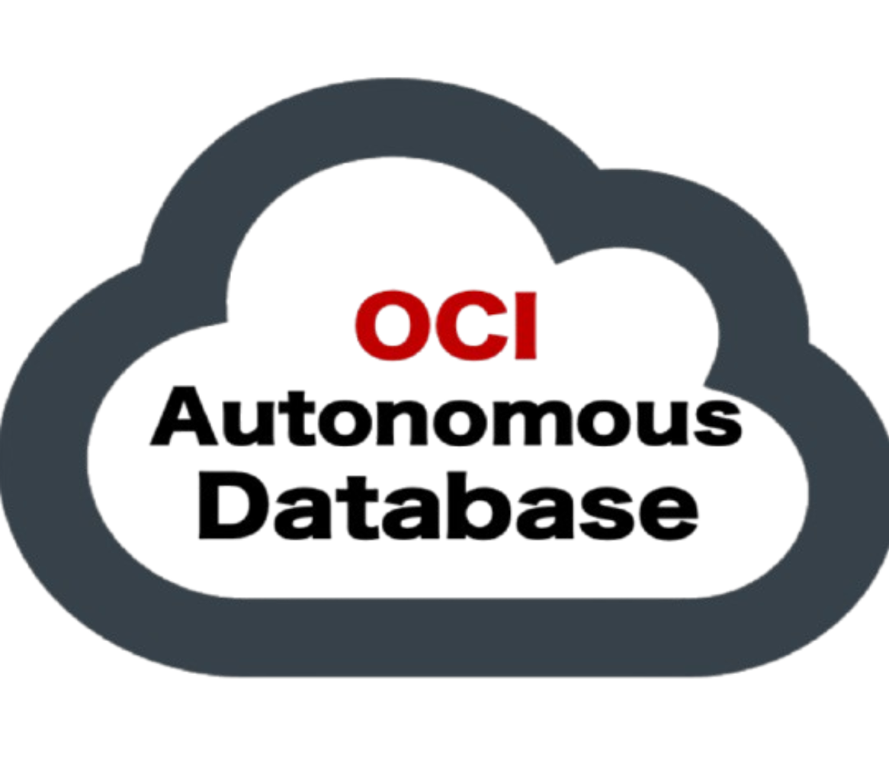






Learning Management System
Development Technical Stack
05. RDBMS
(Relational DataBase Management Tools)
(1) On premise
- Apache H2 version 2.3.232
- MySQL version 8.4.4 (LTS)
- Oracle 19c Release 3
(2) Cloud - OCI (Oracle Cloud Infrastructure) PaaS
- Oracle21c ATP (Autonomous Transaction Processing)
06. Database Client Tool
(1) CLI
- Oracle SQL*Plus version 19.0.0.0.0
- MySQL Shell version 9.2.0
(2) GUI
- Oracle SQL*Developer 24.3.1.347
- MySQL Workbench version 8.0.41
- Visual Source Code with Oracle SQL Developer Extension version 24.4.1
- Visual Source Code with MySQL Shell for VS Code version 1.19.2+9.2.0
- Dbeaver Community Edition version 25.0.0

Slide 10
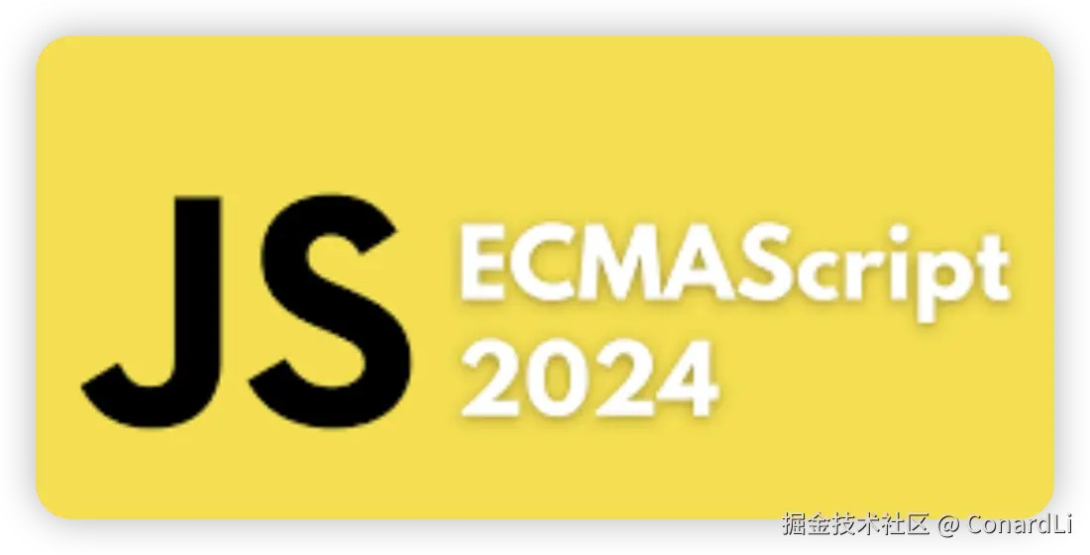






Learning Management System
Development Technical Stack
07. Program Languages
(1) Front-End
- ECMAScript 2024 (ES6+)
- Vanila Script (ES5)
- HTML5, CSS3
(2) Back-End
- JAVA 11/17/21 (Main: 21)
- JShell version 21.0.6
08. Project Build Tools
- Apache Maven version 3.9.9
- Open source Gradle-Groovy version 8.12.1
09. Programming Tools
(1) Platforms
- Microsoft Windows 10 version 22H2
- NodeJS version 23.8.0 (LTS) with npm version 23.8.0, npx version 11.1.0

Slide 11














Learning Management System
Development Technical Stack
09. Programming Tools
...
(2) CLI Tools
- Windows Terminal version 1.21.10351.0
- PowerShell version 7.5.0
- Netcat version 1.12
- nvm (Node Version Manager) version 1.2.2
- MS Sysinternals version 20250213
- gow unix commands for windows version 0.8.0
(3) GUI Tools
- Sublime-text version 4-4186
- 7zip version 24.09
- Postman version 3.10.11
- Visual Source Code with Postman Extension version 1.8.1
- Visual Source Code with REST Client Extension version 0.25.1
- Spring Initializr
(4) Web Browser (Cross Browsing Test)
- Microsoft Edge, Google Chrome, Mozilla Firefox

Slide 12





Learning Management System
Development Technical Stack
10. SCM Tools
(1) CLI
- gh (GitHub) version 2.68.1
- git version 2.48.1
- gitignore version 3.4.17
(2) GUI
- GitHub Desktop Client version 3.4.17
- Visual Source Code Integrated git with Git Graph Extension version 1.30.0
- Eclipse Integrated Git (m2e)
- Intellij IDEA Integrated Git
(3) Remote Repositories
- github.com
- Team Development
11. Main Frameworks & Core Libraries
(1) Front-End
- React version 19.9.0

Slide 13








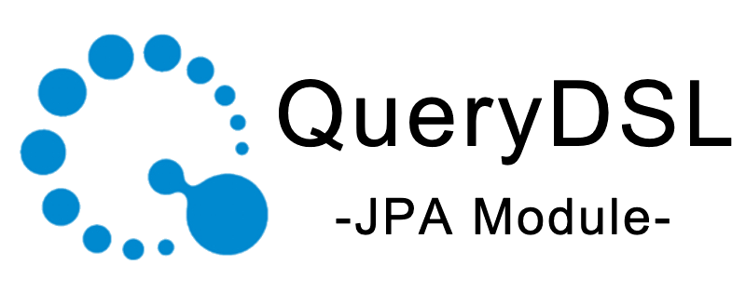
Learning Management System
Development Technical Stack
11. Main Frameworks & Core Libraries
...
- Bootstrap version 5.3.3
- JQuery version 3.7.1
- JQuery-migrate version 3.5.2
(2) Back-End
- Spring Boot version 3.4.3 Latest
- Spring MVC Framework version 3.4.3
- Lombok plugin & library version 1.18.36
- Apache MyBatis SQL Mapper Framework version 3.5.19
- Spring bridge for MyBatis sql mapping framework version 3.0.4
- Spring JDBC / Spring Data / Spring Data JDBC
- Standard Java Persistence API version 3.1.0
- Spring Data JPA version 3.4.3
- Spring Data JPA QueryDSL version 3.4.3
- Spring Security Framework version 6.4.3

Slide 14








Learning Management System
Development Technical Stack
11. Main Frameworks & Libraries
...
- Hibernate JPA ORM framework version 6.6.8.FINAL
- Standard JEE Servlet version 6.0, JSP version 3.1, JSTL version 3.0.1
- Spring-Thymeleaf Template Engine version 3.1.3.RELEASE
- Quartz Job Scheduler Framework version 2.5.0
- Spring-Quartz Bridge Library version 3.4.3
- UUID type 1, 3, 4, 5 Generation Library
- BCrypt (SHA-256) Password Encoder
(3) Test Frameworks
- JUnit Jupyter Test Framework version 5.11.4
(4) JDBC Driver
- H2 version 2.232
- mysql-connector/J version 9.1.0
- Oracle ojdbc11 on premise
- Oracle ojdbc11-production for OCI (Oracle Cloud)

Slide 15




Learning Management System
Development Technical Stack
12. Servers
(1) Web Server
- Nginx version 1.27.4
- Apache Tomcat version 9.0.102
- npm serve version 14.2.4
(2) Web Application Server (WAS)
- Apache Tomcat version 10.1.39
- Apache Tomcat version 9.0.102
- Spring Boot Embedded Tomcat version 10.1.36
13. Team Collaborative Tools
(1) Kakaotalk
(2) Figma

Slide 16
Learning Management System
UX·UI Wireframes and StoryBoard

Slide 17
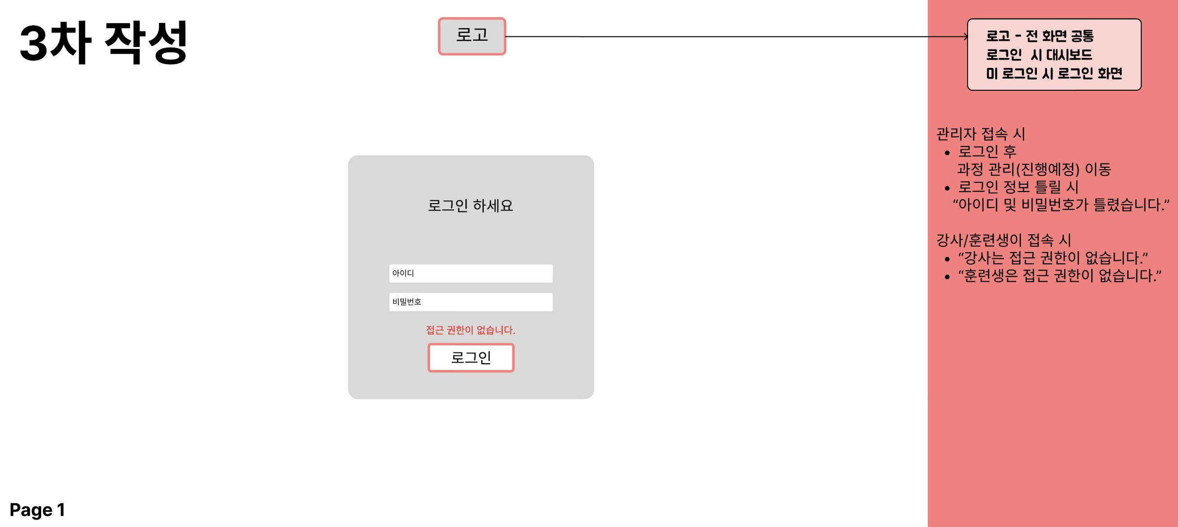
Learning Management System
UX·UI Wireframes and Story Board
4-1. Wireframes

Slide 18
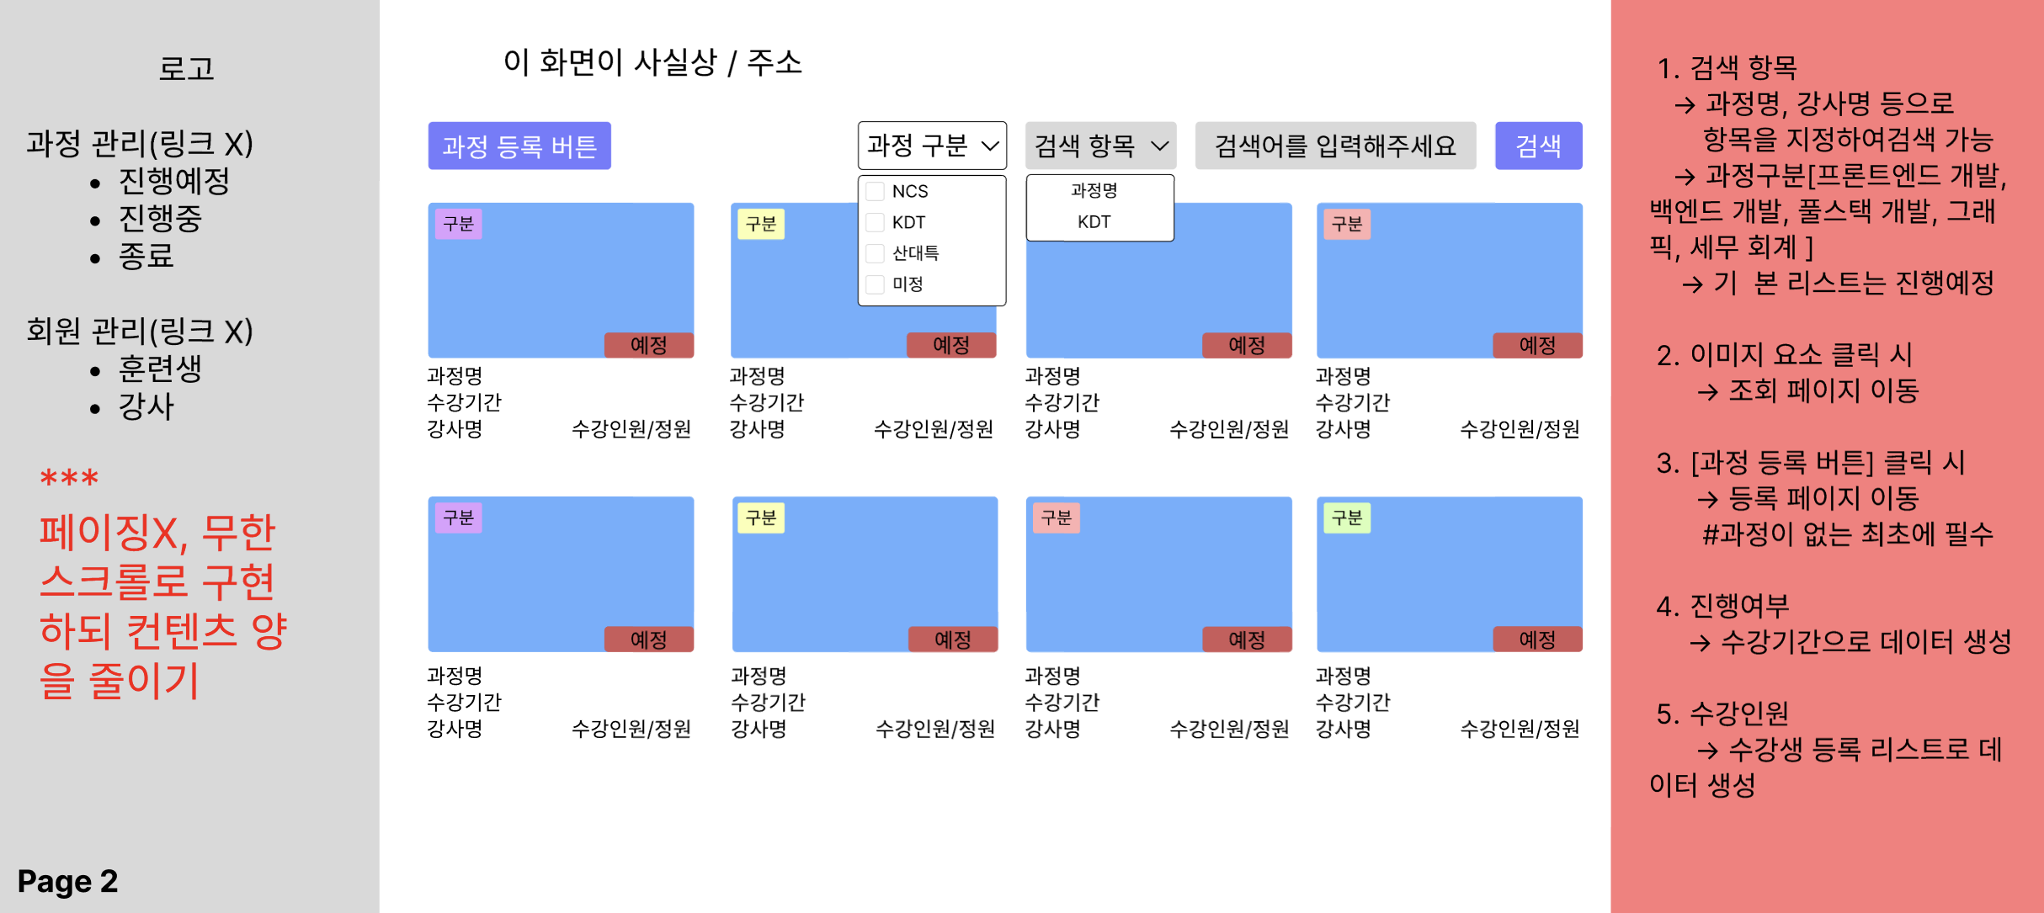
Learning Management System
UX·UI Wireframes and Story Board
4-1. Wireframes

Slide 19
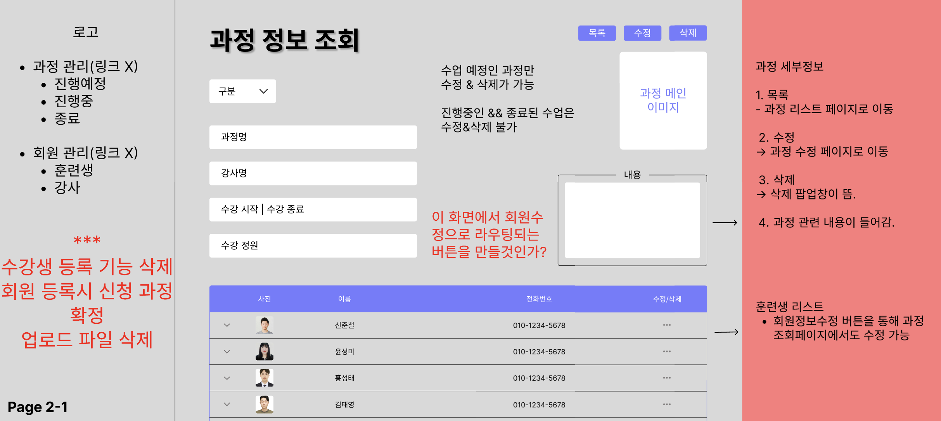
Learning Management System
UX·UI Wireframes and Story Board
4-1. Wireframes

Slide 20
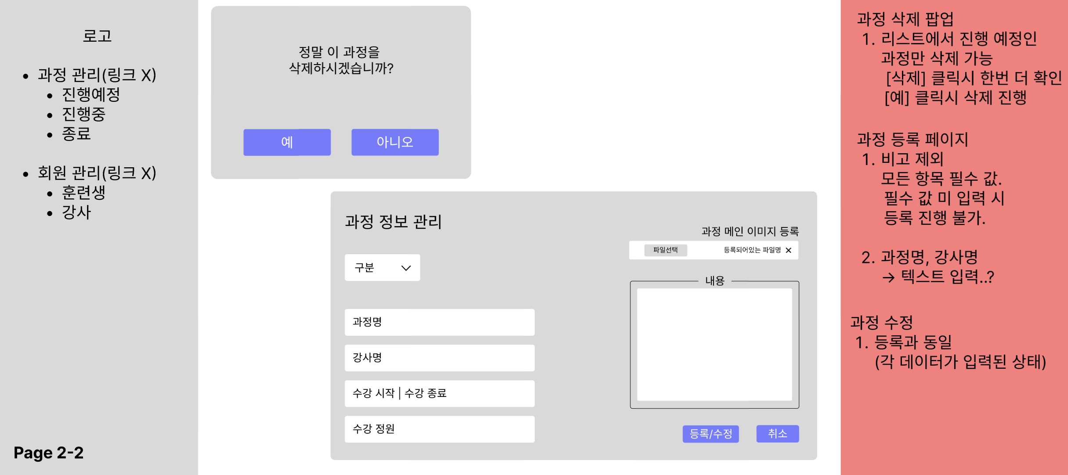
Learning Management System
UX·UI Wireframes and Story Board
4-1. Wireframes

Slide 21
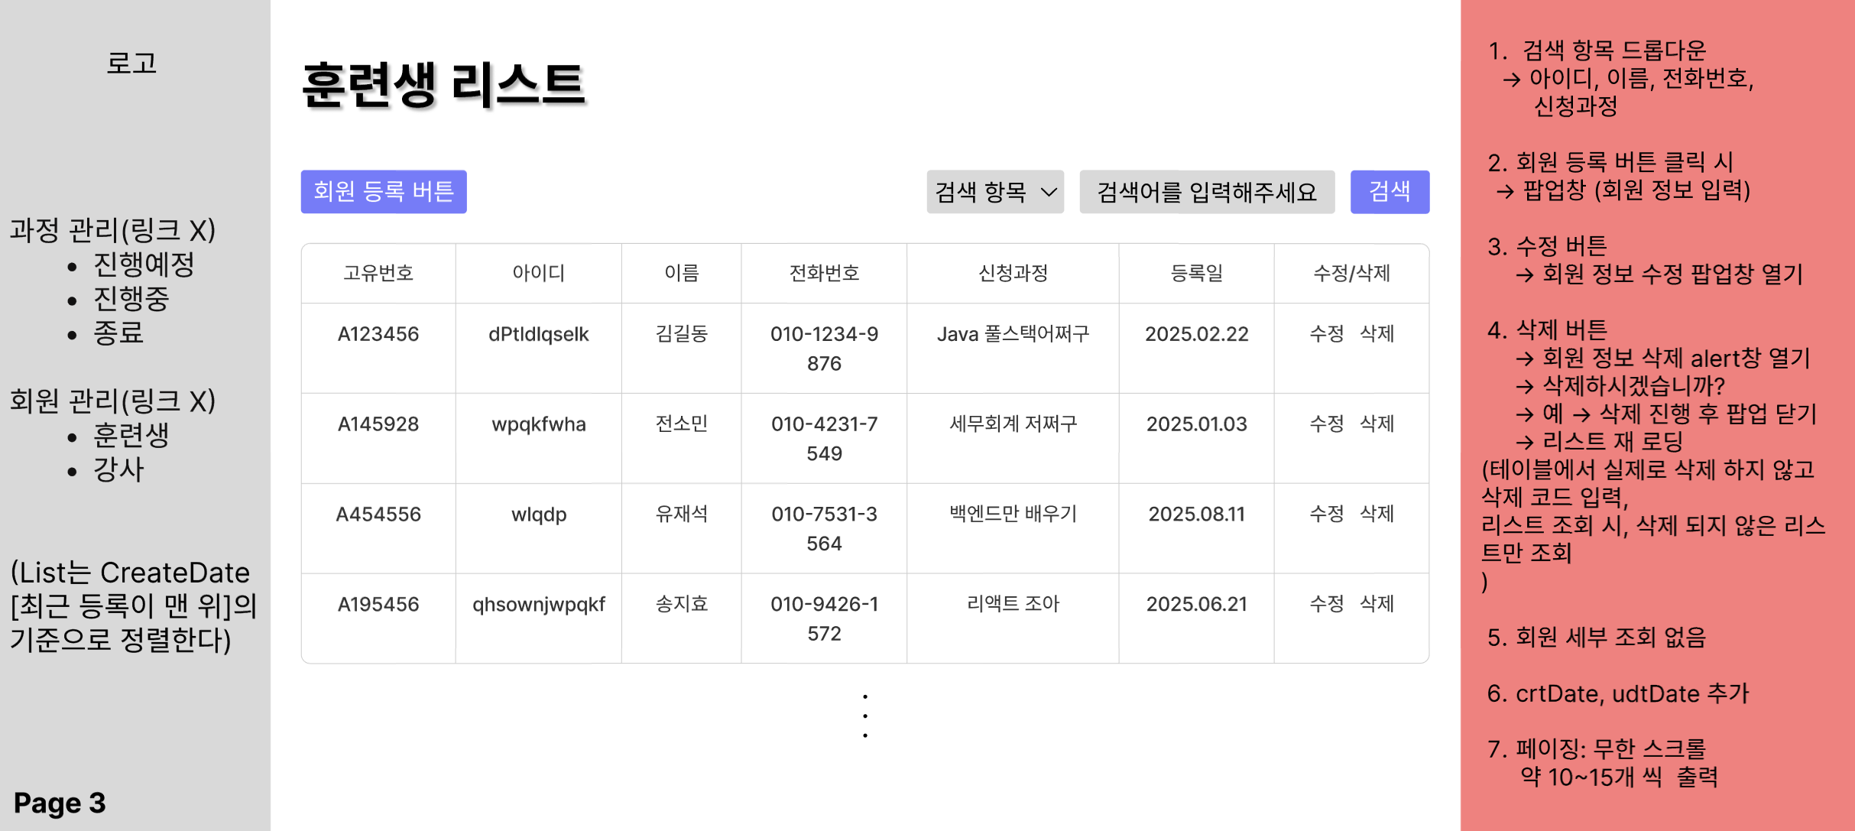
Learning Management System
4-1. Wireframes

Slide 22
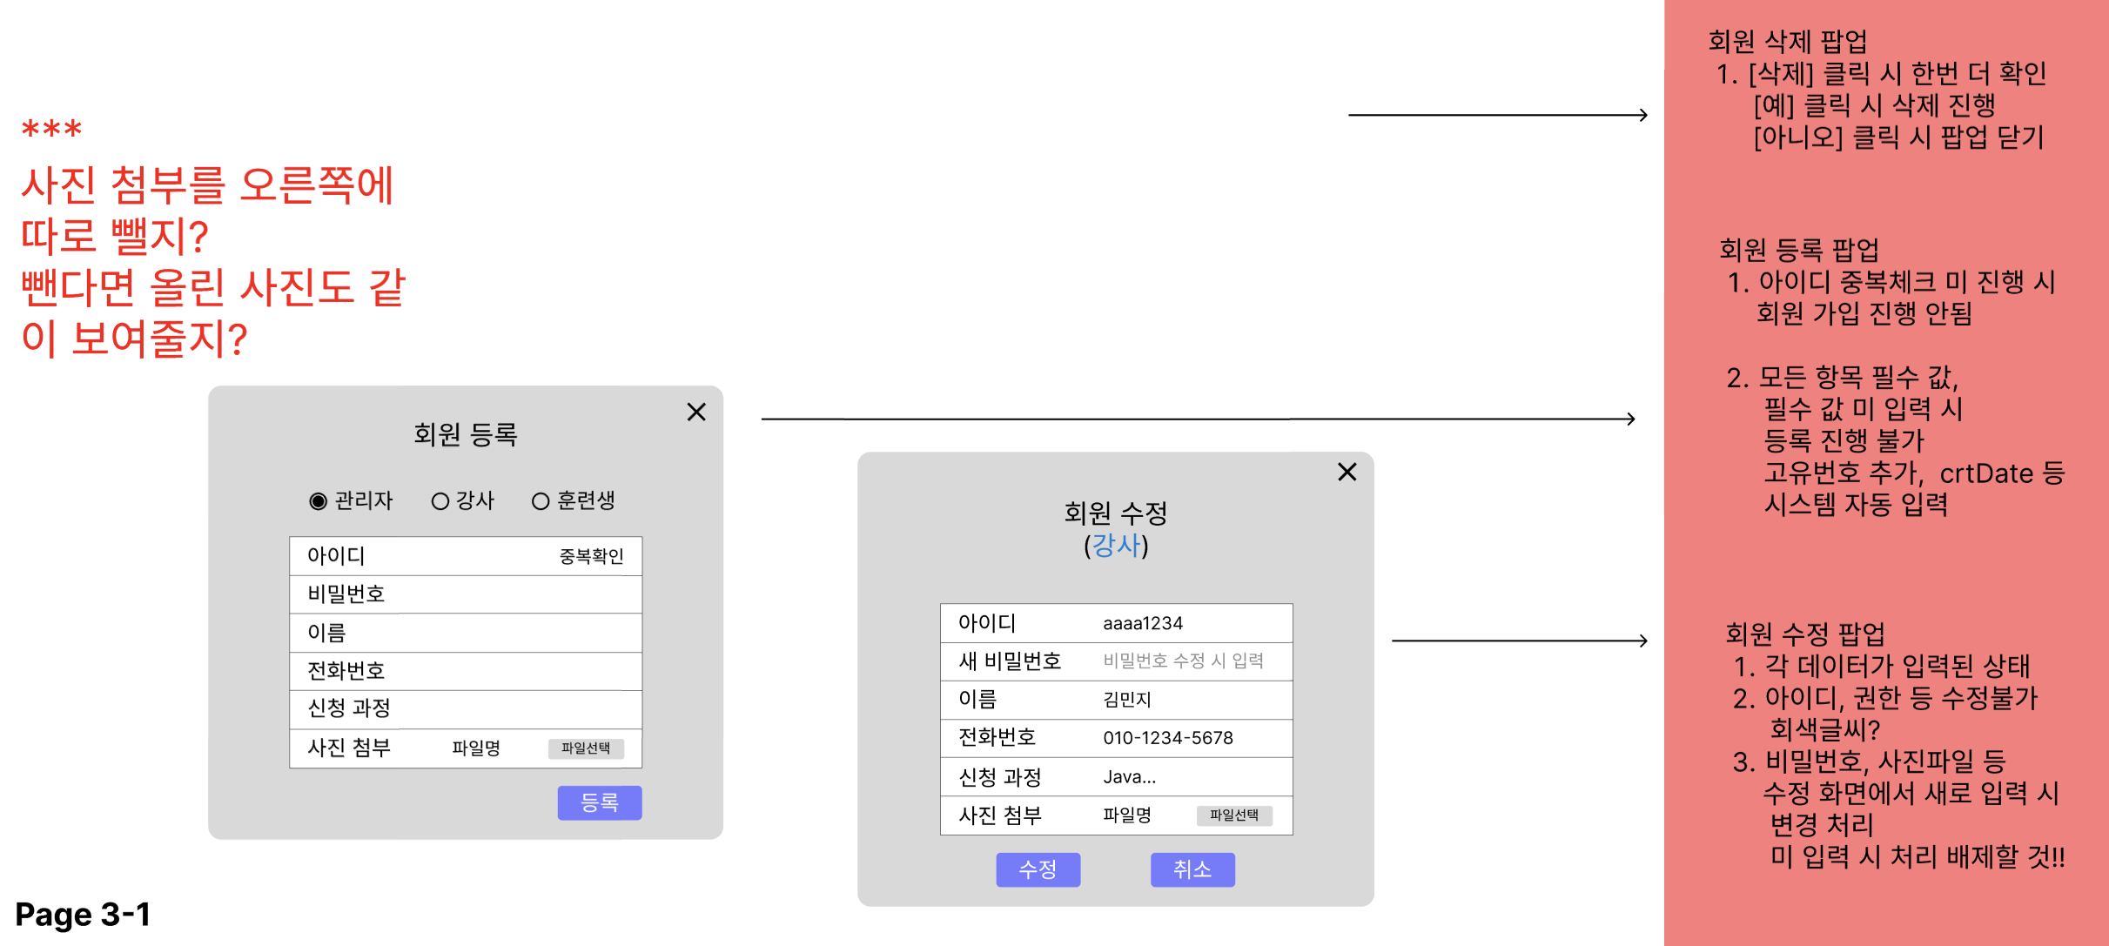
Learning Management System
UX·UI Wireframes and Story Board
4-1. Wireframes

Slide 23
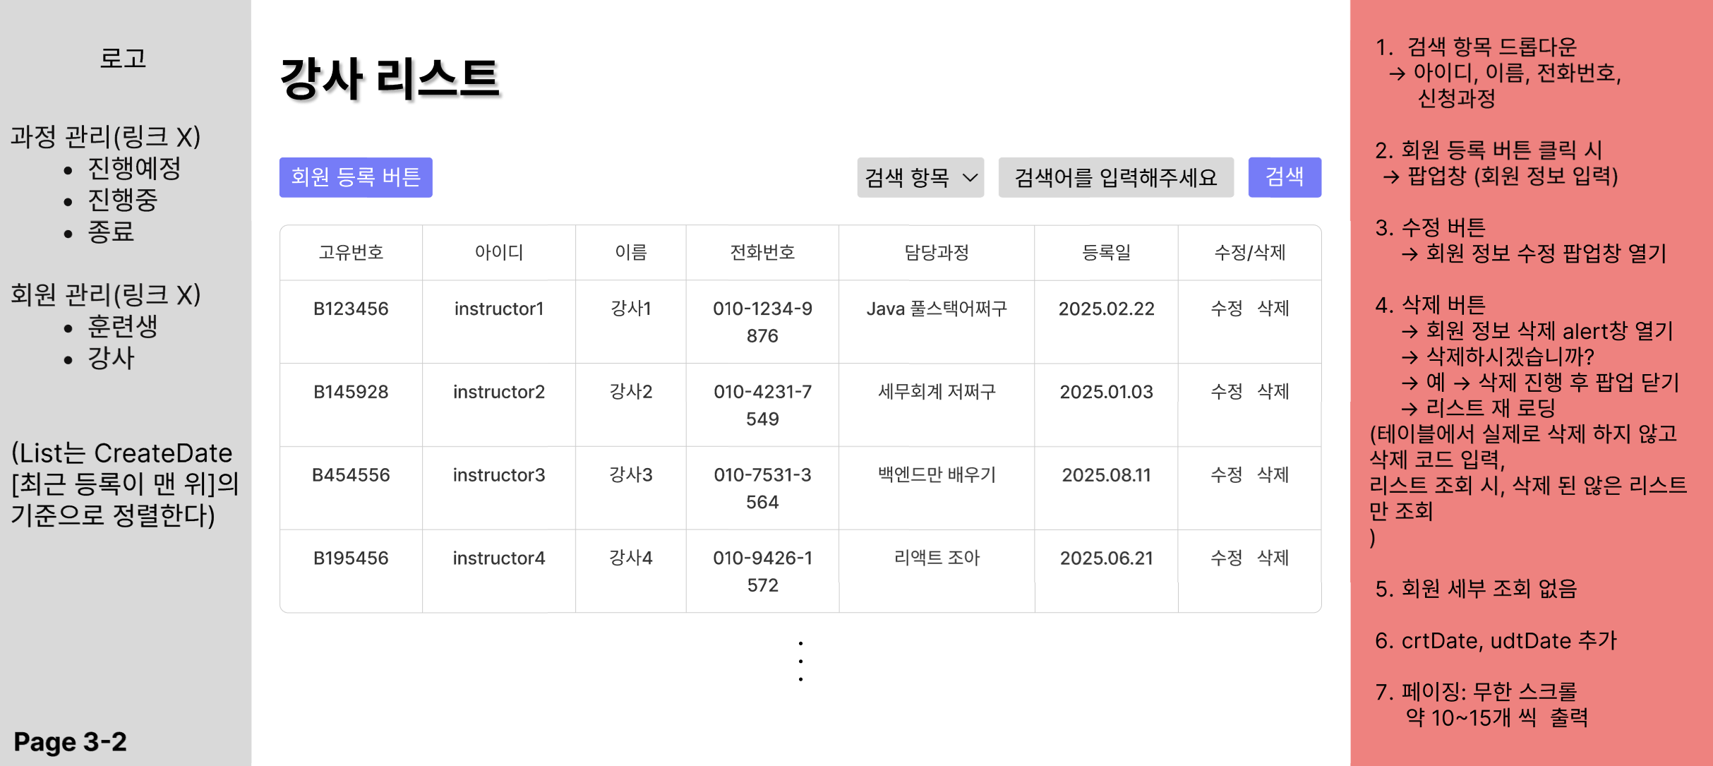
Learning Management System
UX·UI Wireframes and Story Board
4-1. Wireframes

Slide 24
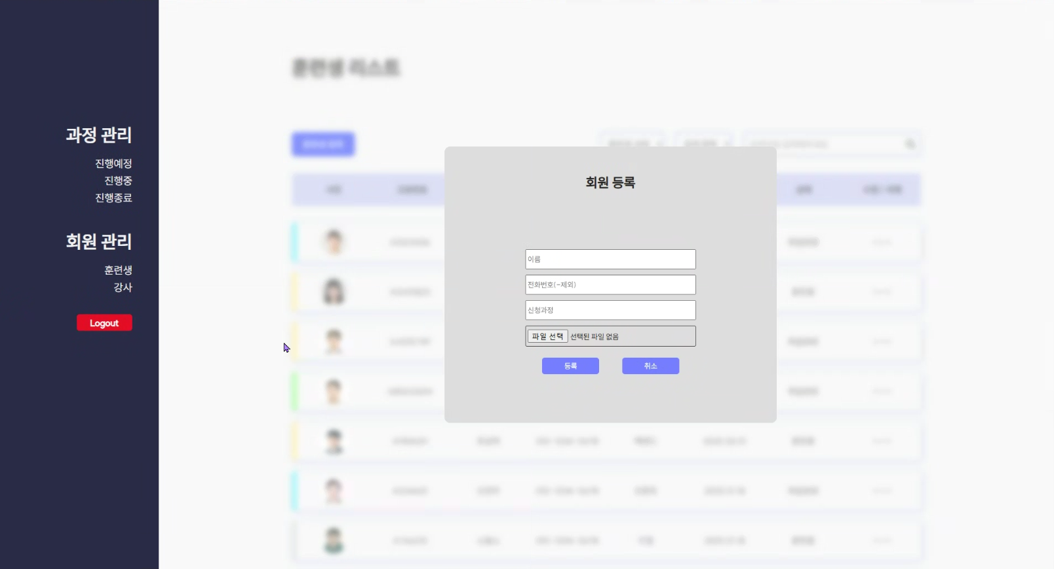
Learning Management System
UX·UI Wireframes and Story Board
4-2. Storyboard

Slide 25
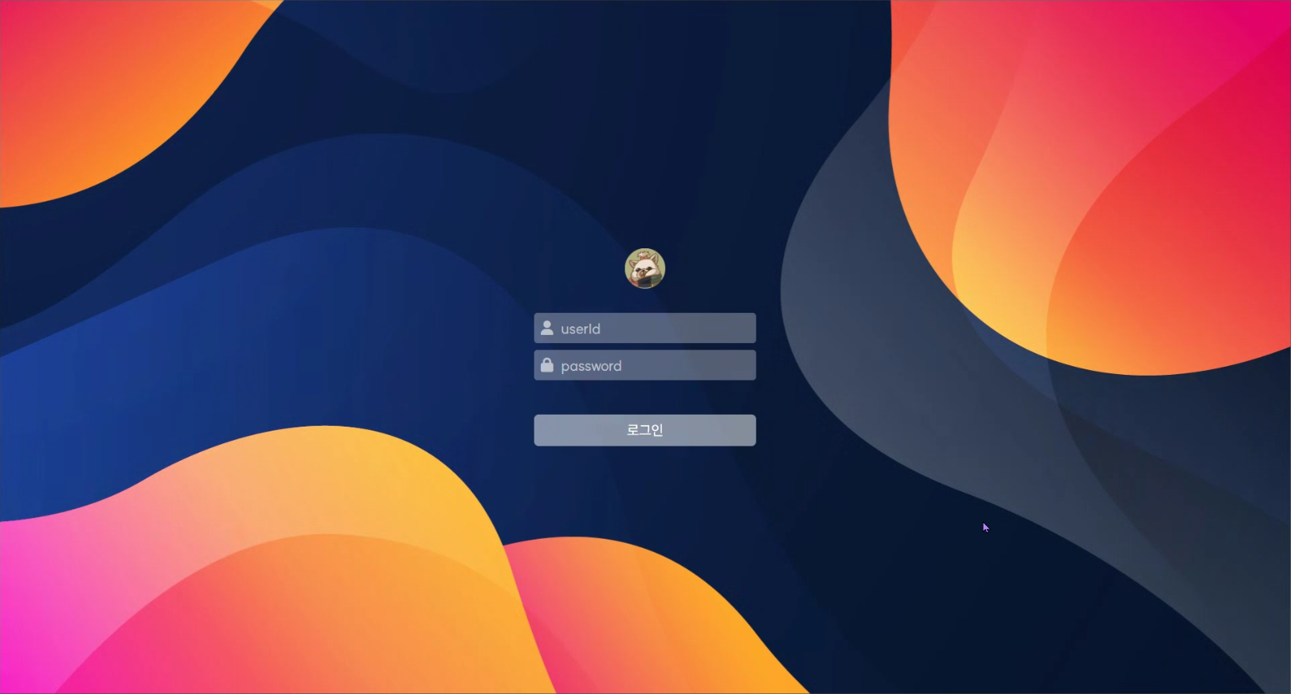
Learning Management System
UX·UI Wireframes and Story Board
4-2. Storyboard

Slide 26
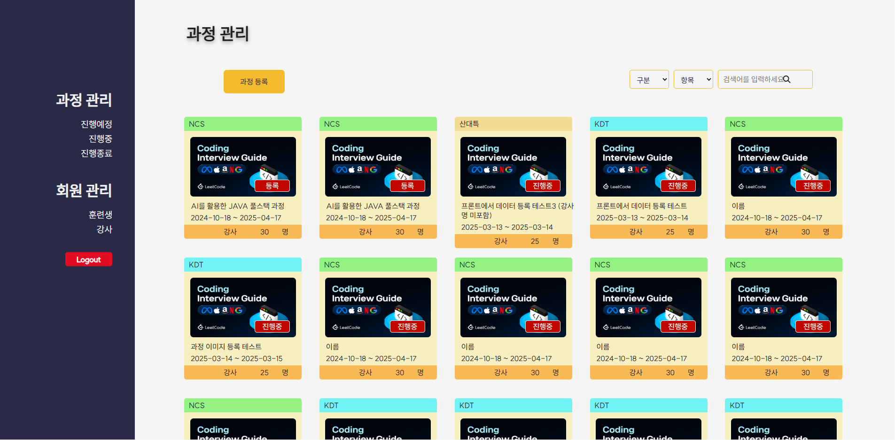
Learning Management System
UX·UI Wireframes and Story Board
4-2. Storyboard

Slide 27
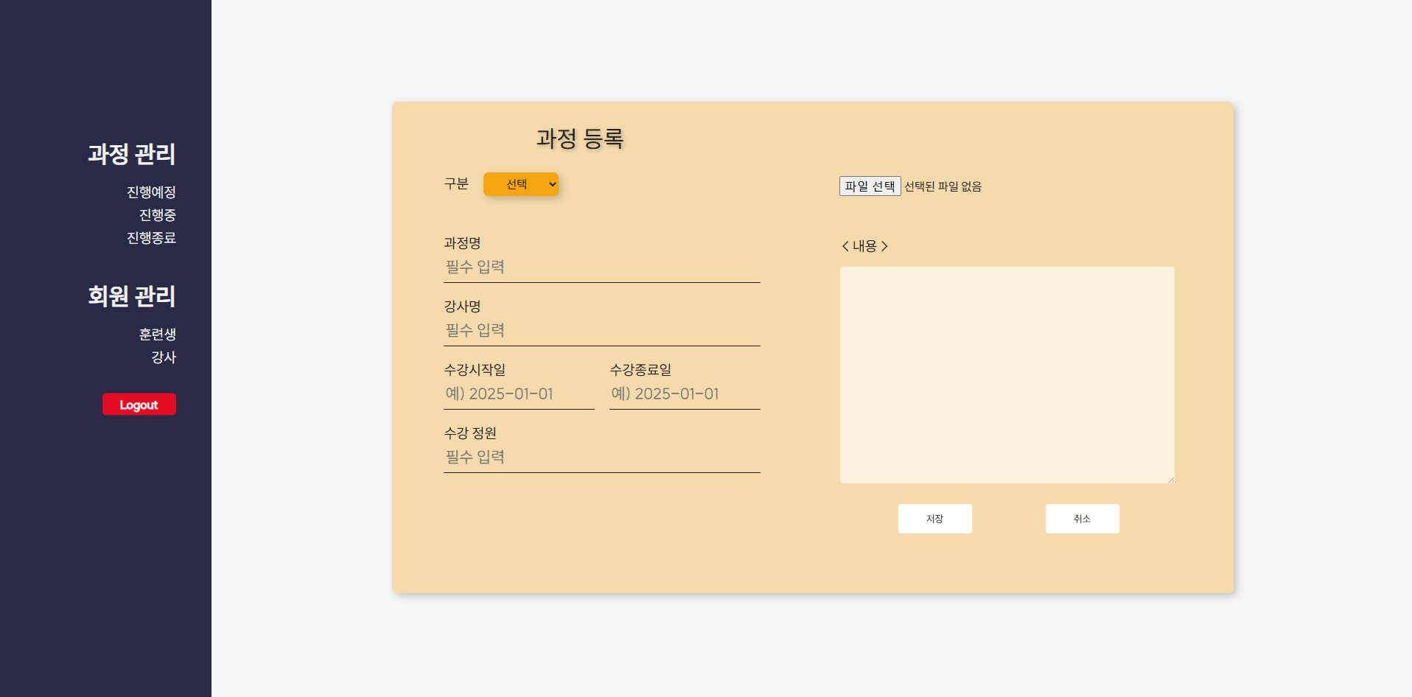
Learning Management System
UX·UI Wireframes and Story Board
4-2. Storyboard

Slide 28
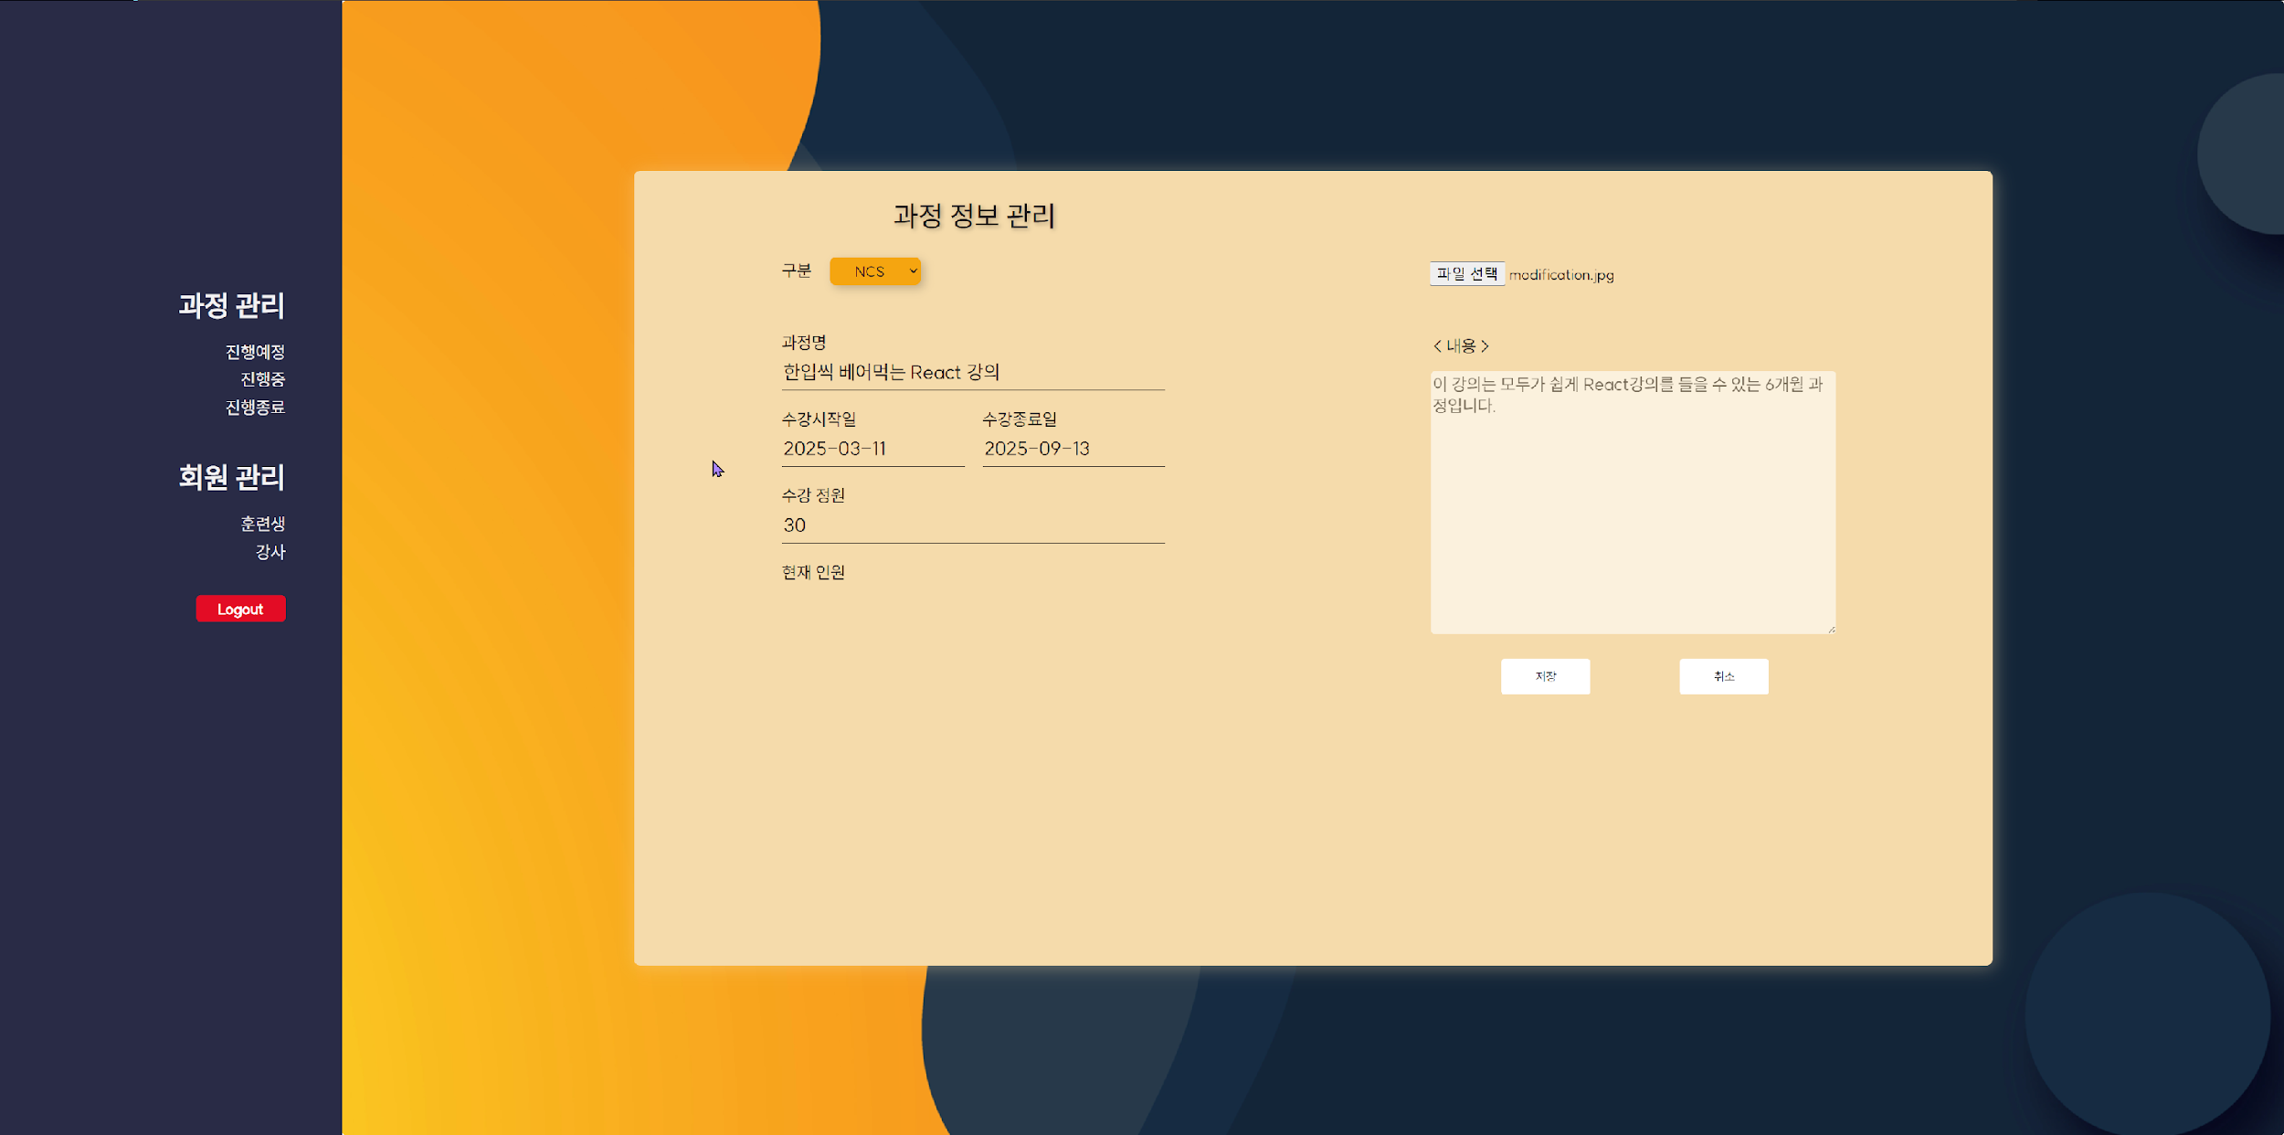
Learning Management System
UX·UI Wireframes and Story Board
4-2. Storyboard

Slide 29
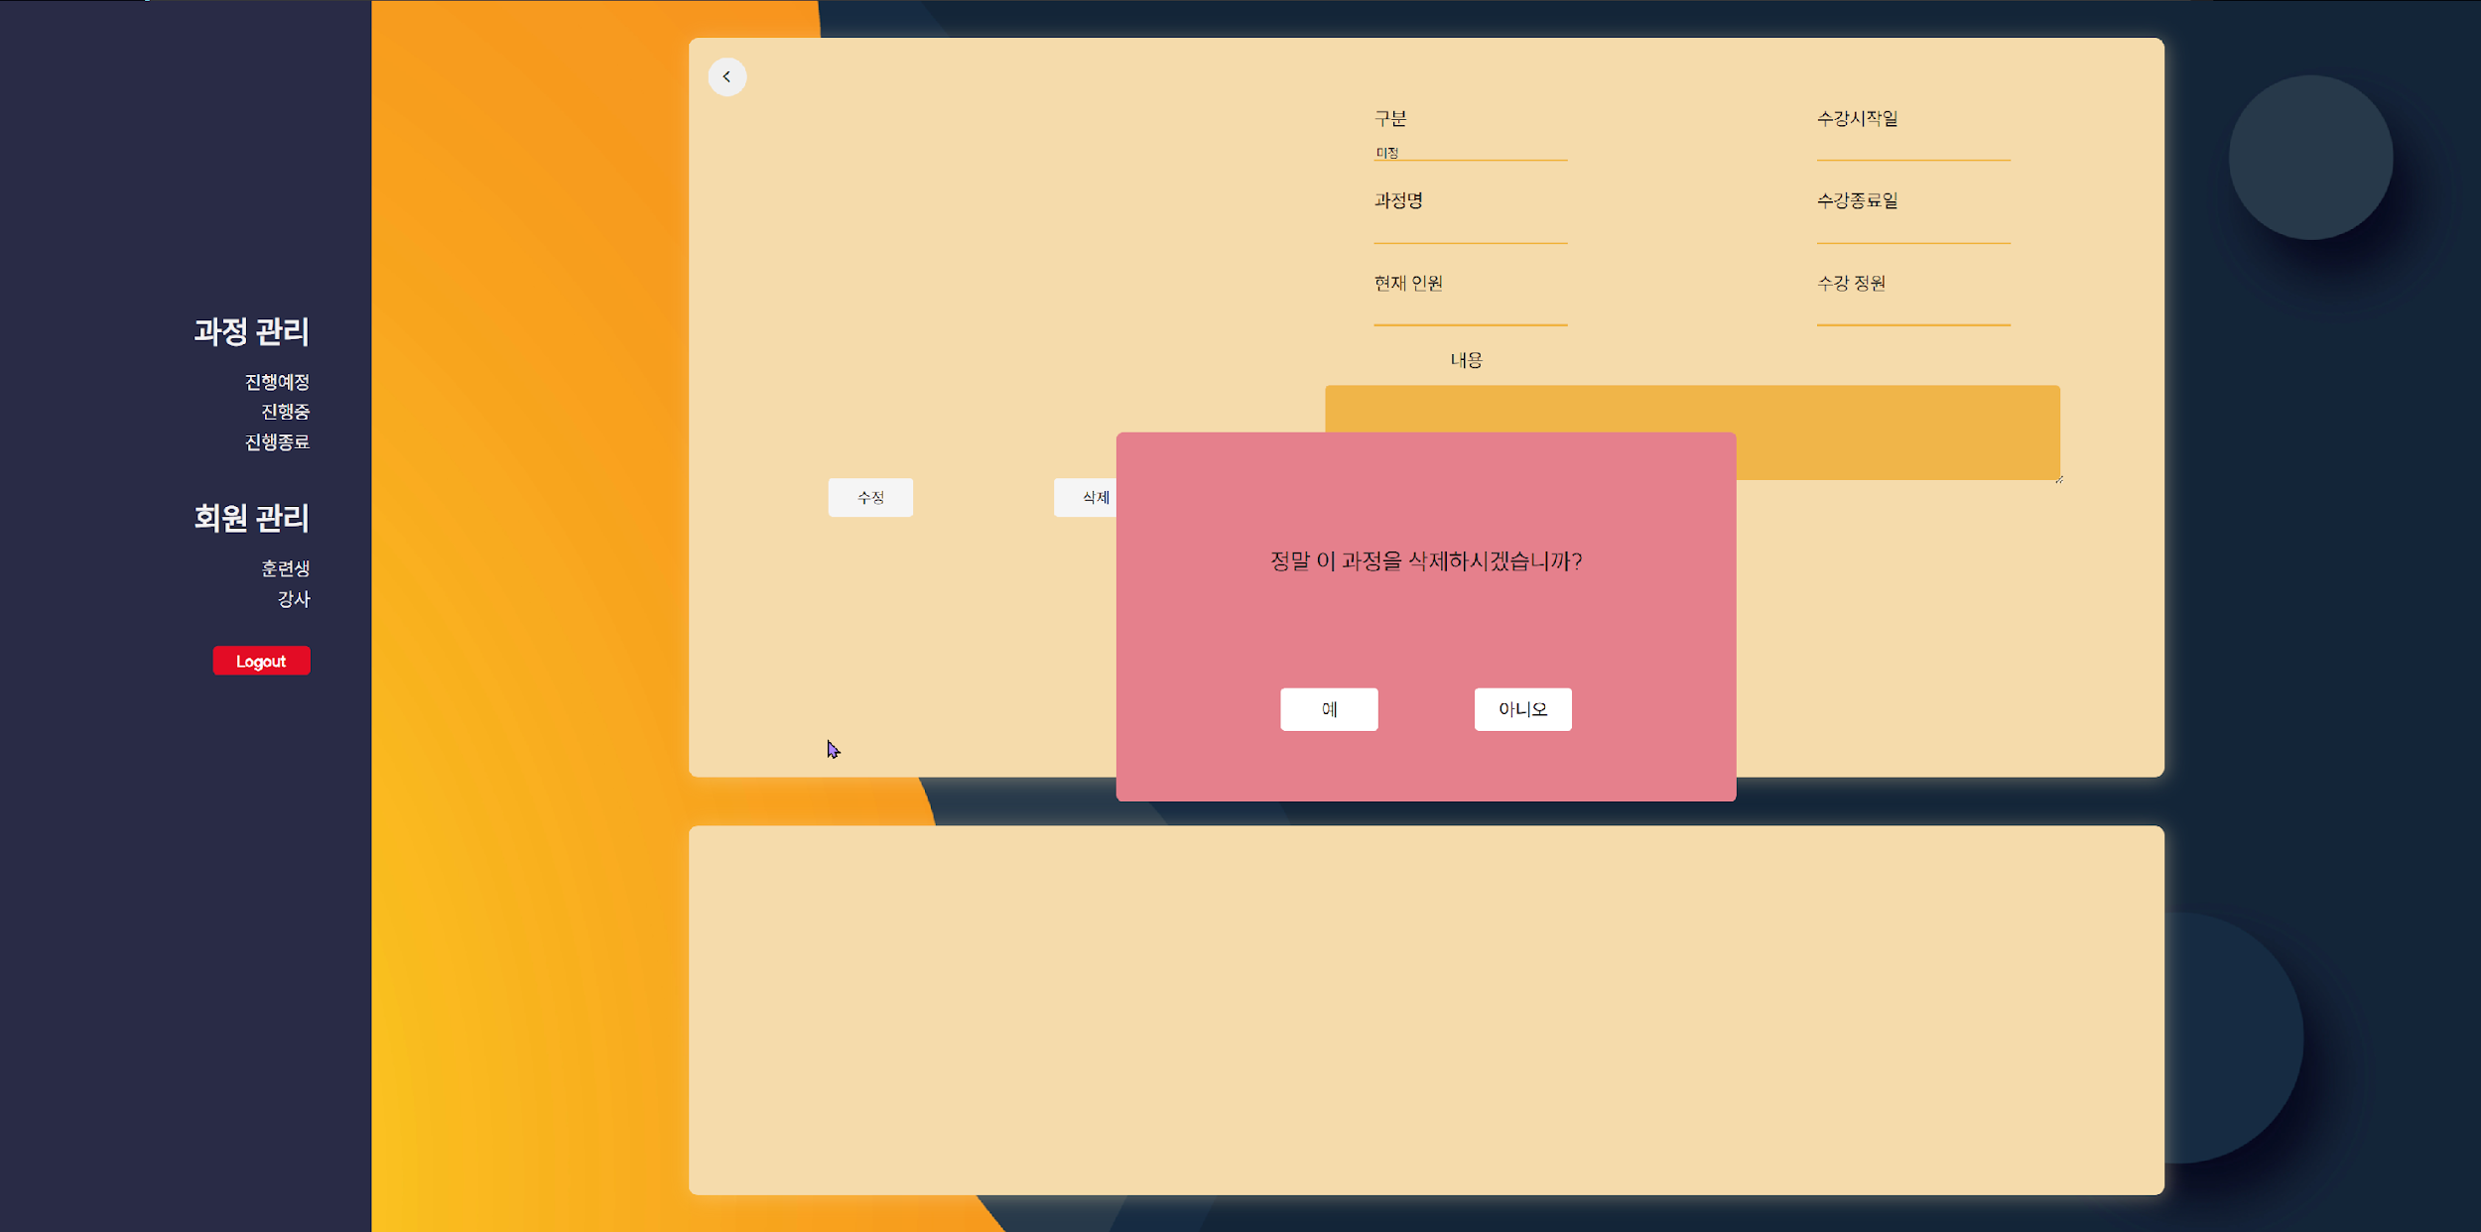
Learning Management System
UX·UI Wireframes and Story Board
4-2. Storyboard

Slide 30
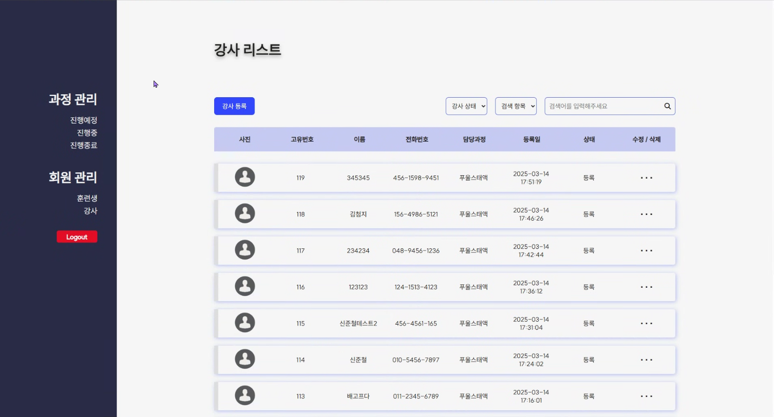
Learning Management System
UX·UI Wireframes and Story Board
4-2. Storyboard

Slide 31
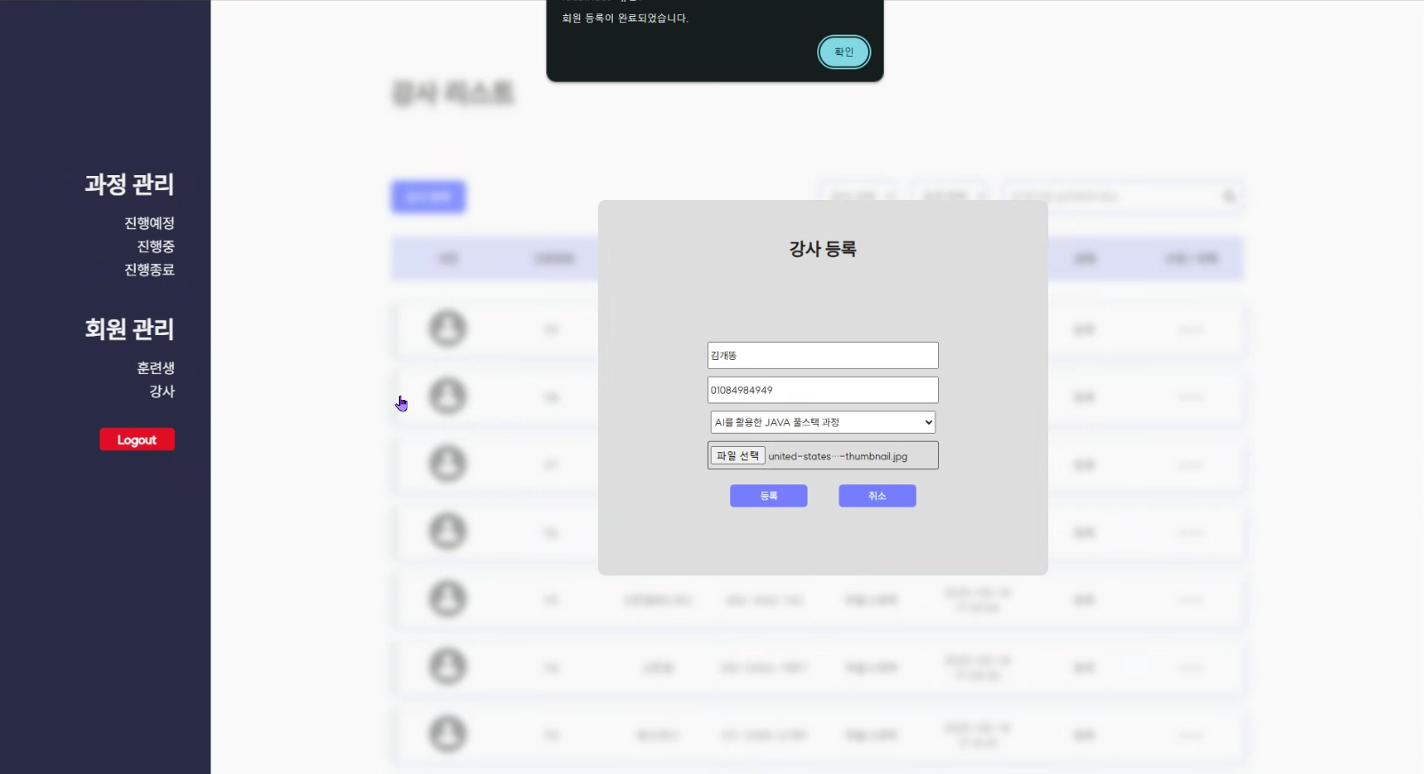
Learning Management System
UX·UI Wireframes and Story Board
4-2. Storyboard

Slide 32
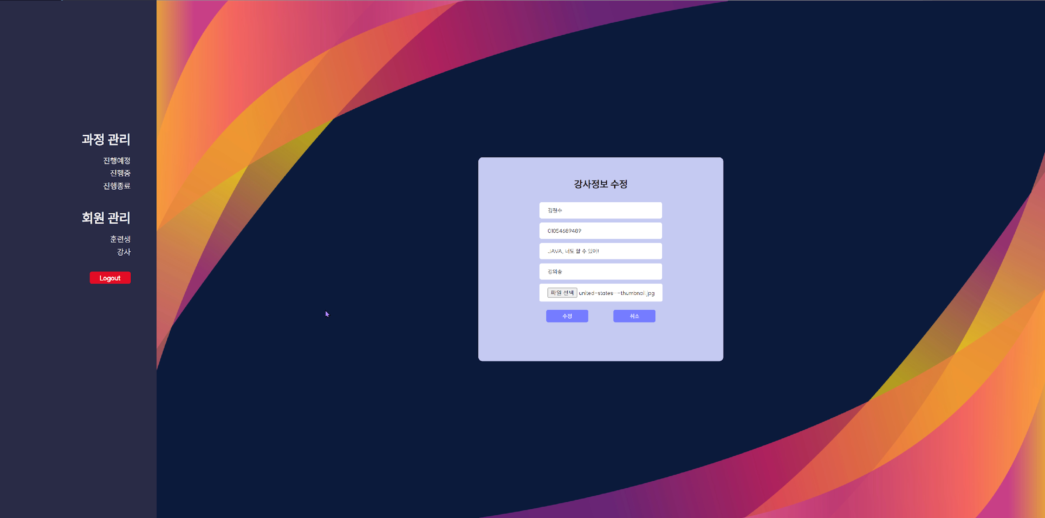
Learning Management System
UX·UI Wireframes and Story Board
4-2. Storyboard

Slide 33
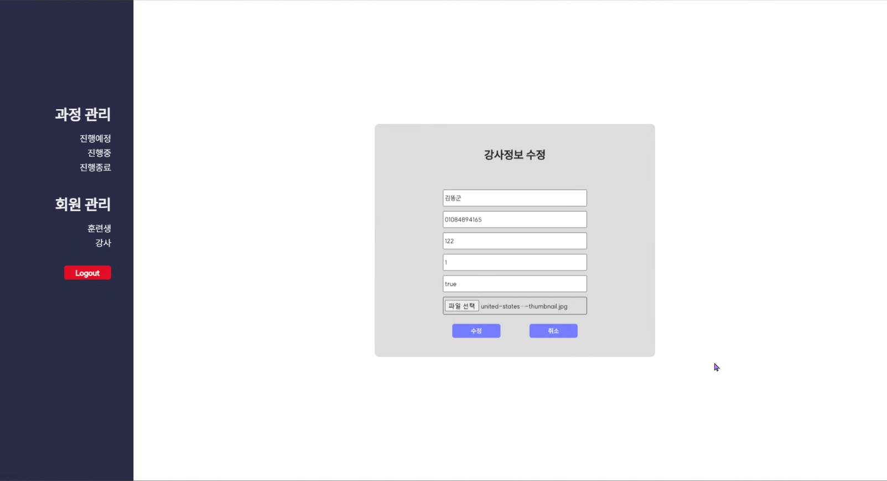
Learning Management System
UX·UI Wireframes and Story Board
4-2. Storyboard

Slide 34

Learning Management System
UX·UI Wireframes and Story Board
4-2. Storyboard

Slide 35

Learning Management System
UX·UI Wireframes and Story Board
4-2. Storyboard

Slide 36
Learning Management System
Relational Data Modeling

Slide 37
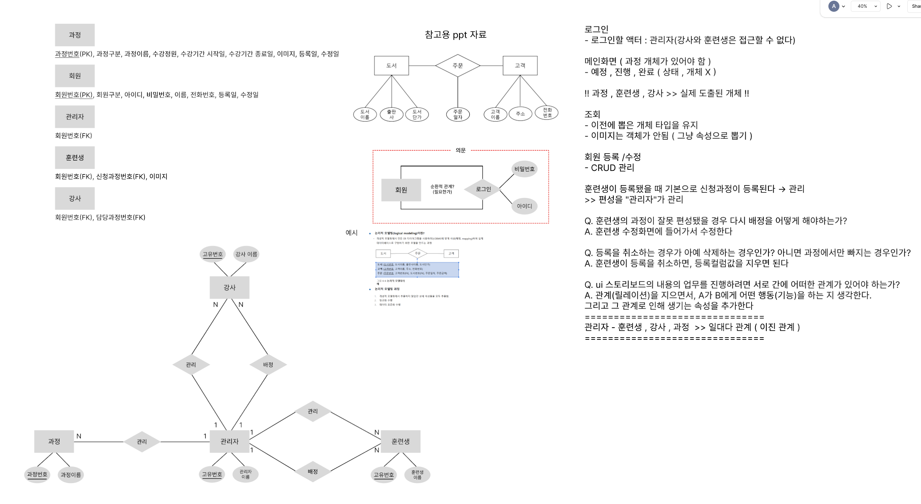
Learning Management System
Relational Data Modeling
5-1. ERD

Slide 38
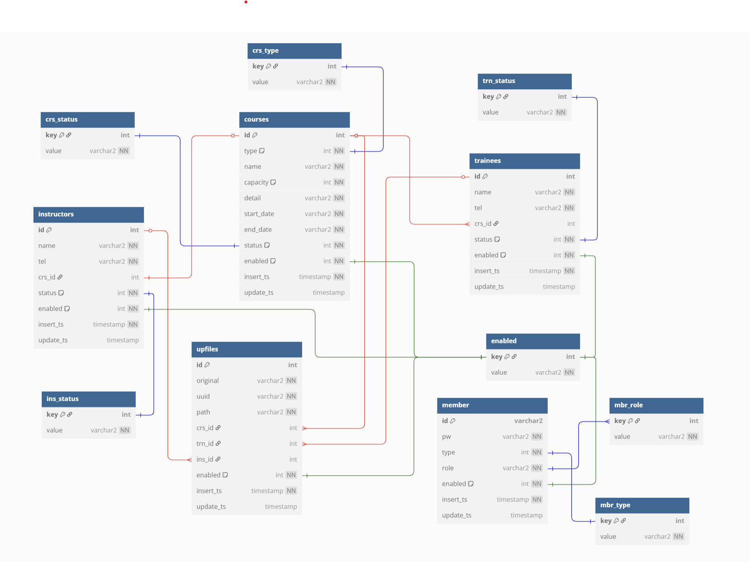
Learning Management System
Relational Data Modeling
5-2. Logical Model

Slide 39
Learning Management System
Core Sources

Slide 40
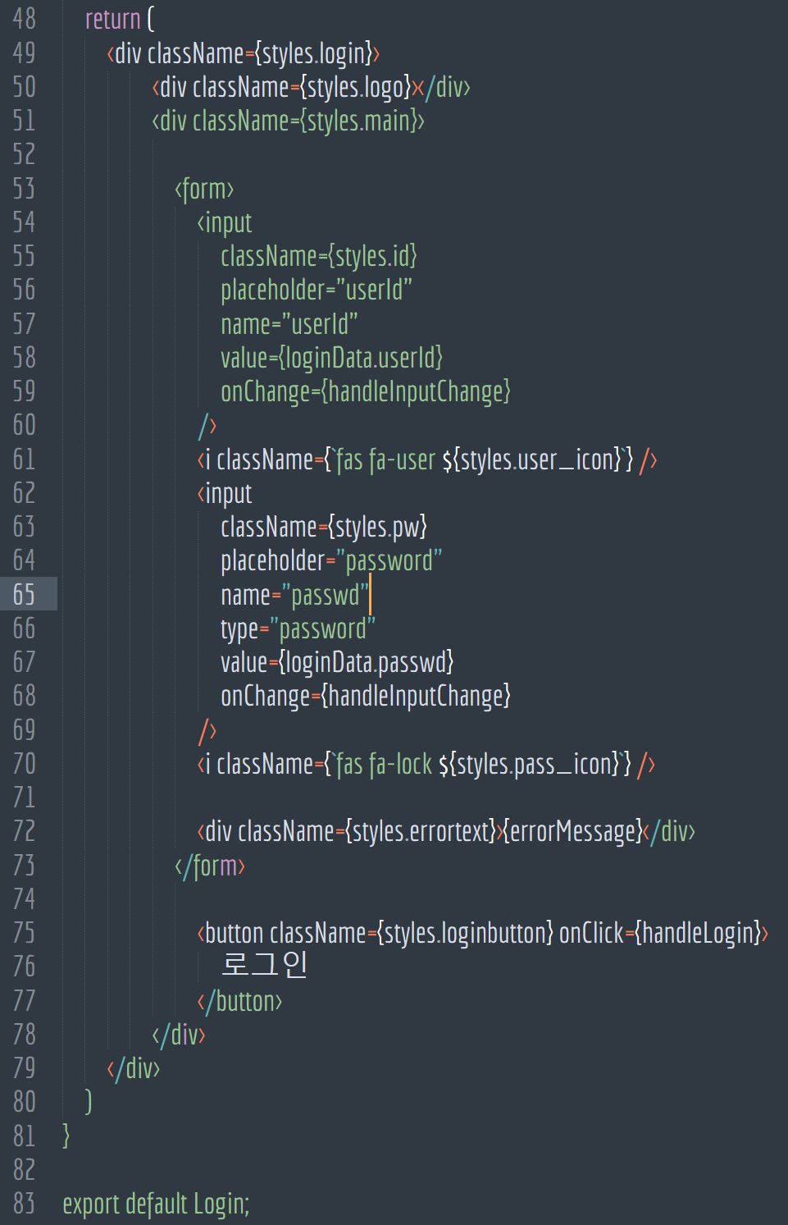
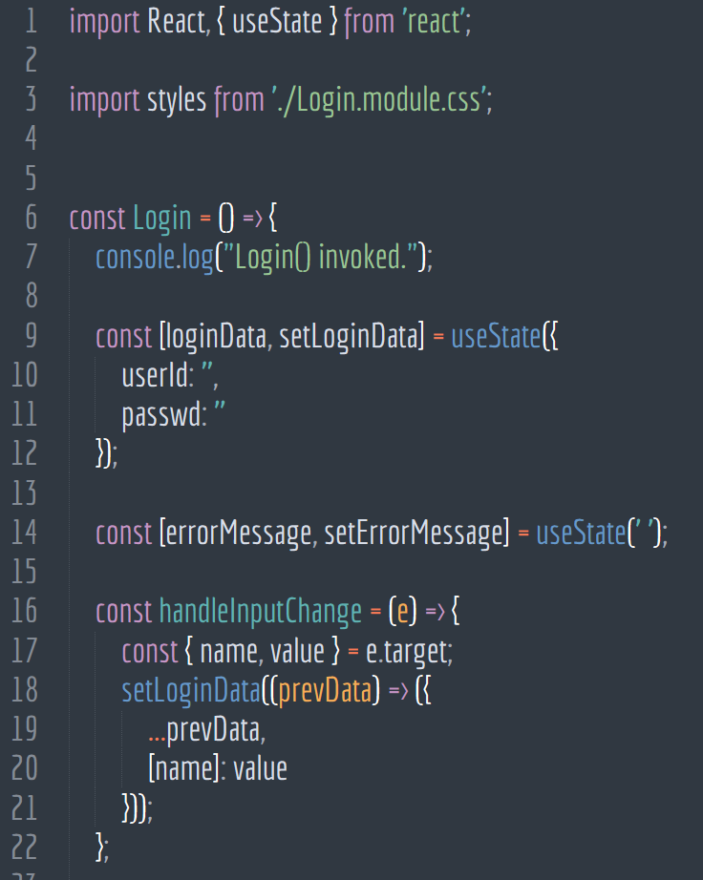
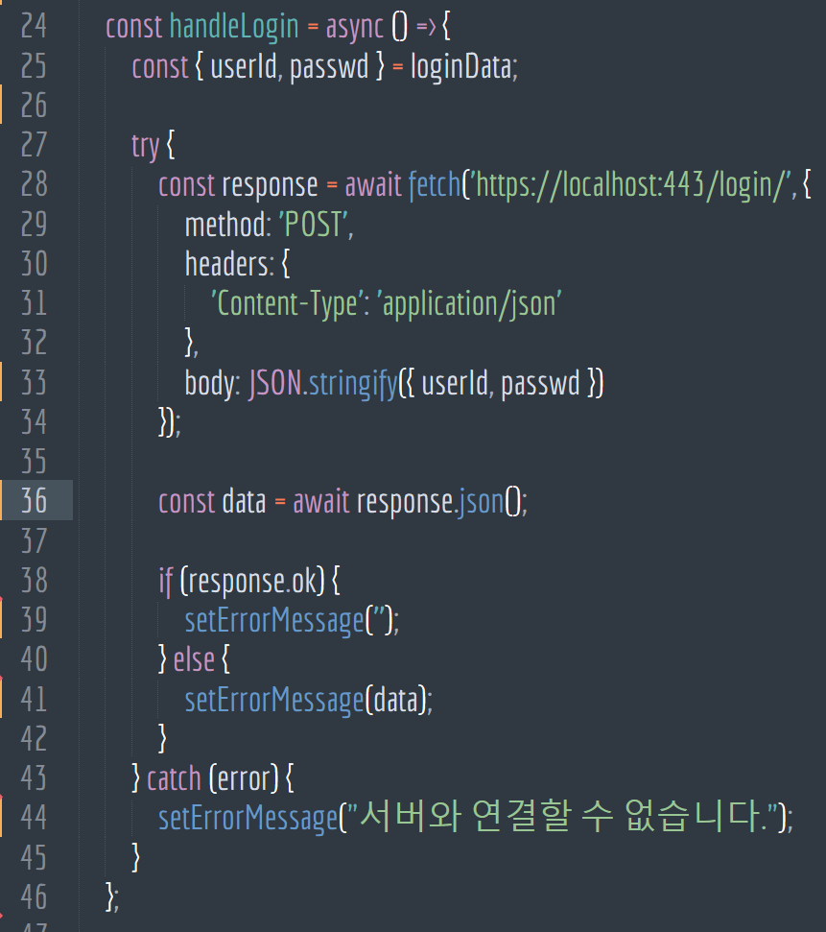
Core Sources_Front-End
Learning Management System
7-8. React - Sign-In

Slide 41
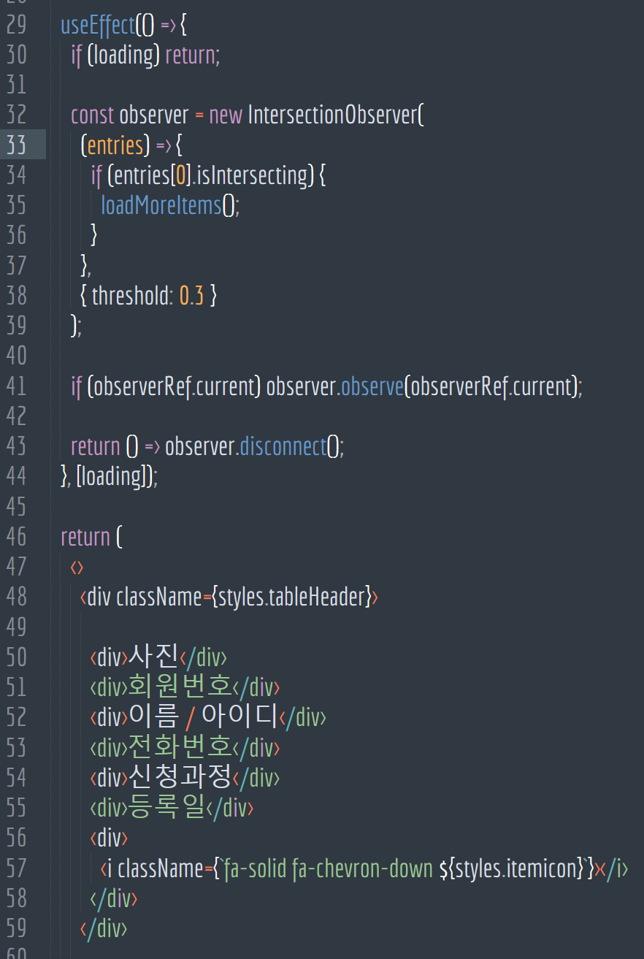
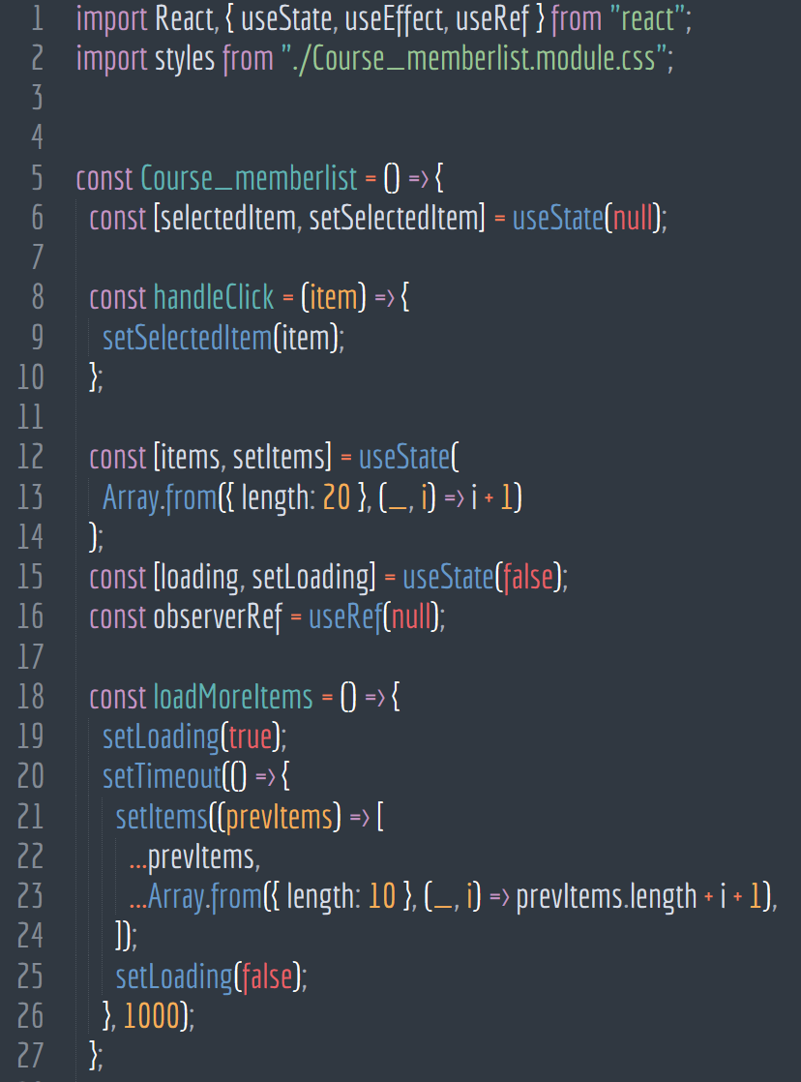
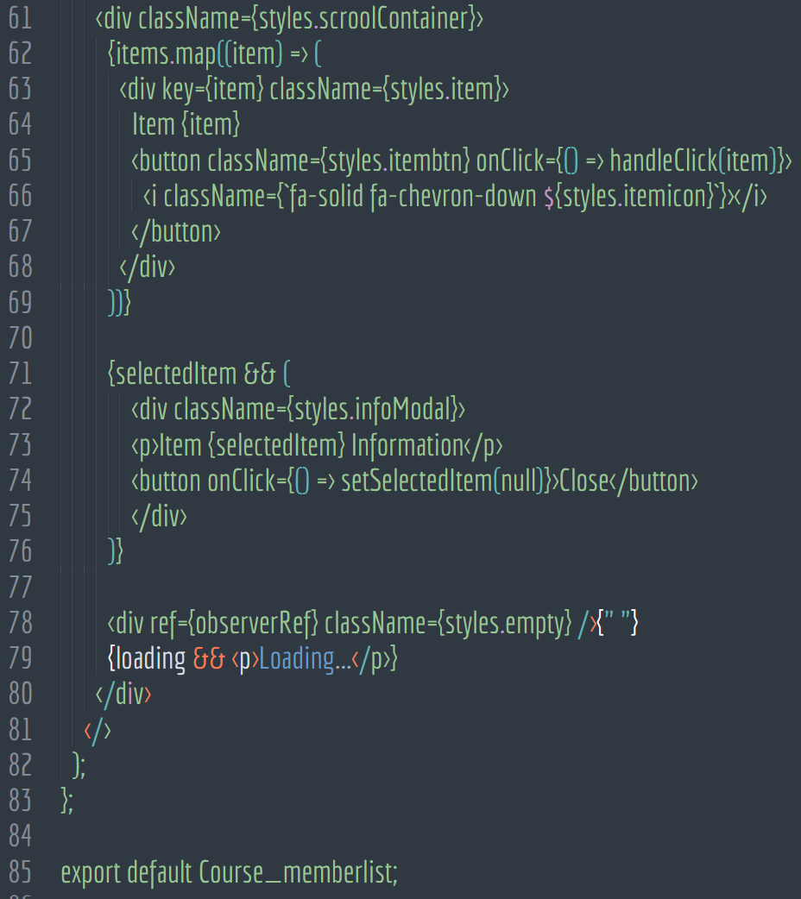
Core Sources_Front-End
Learning Management System
7-9. React - Course

Slide 42
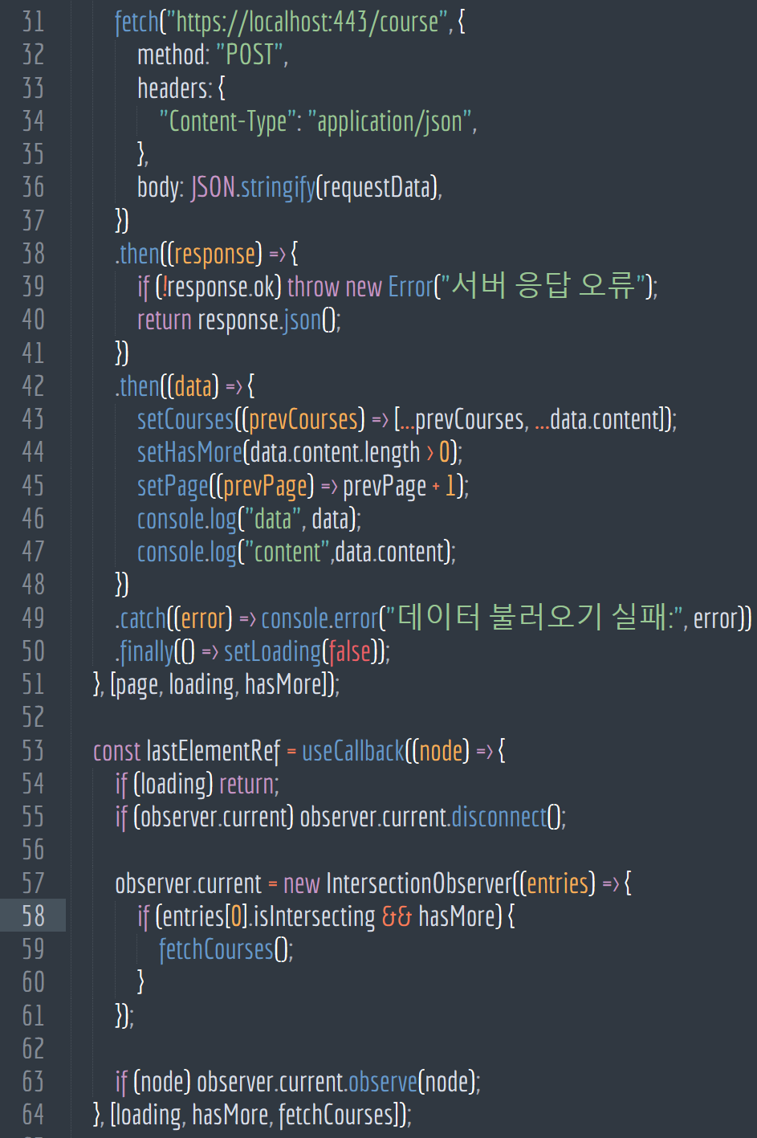
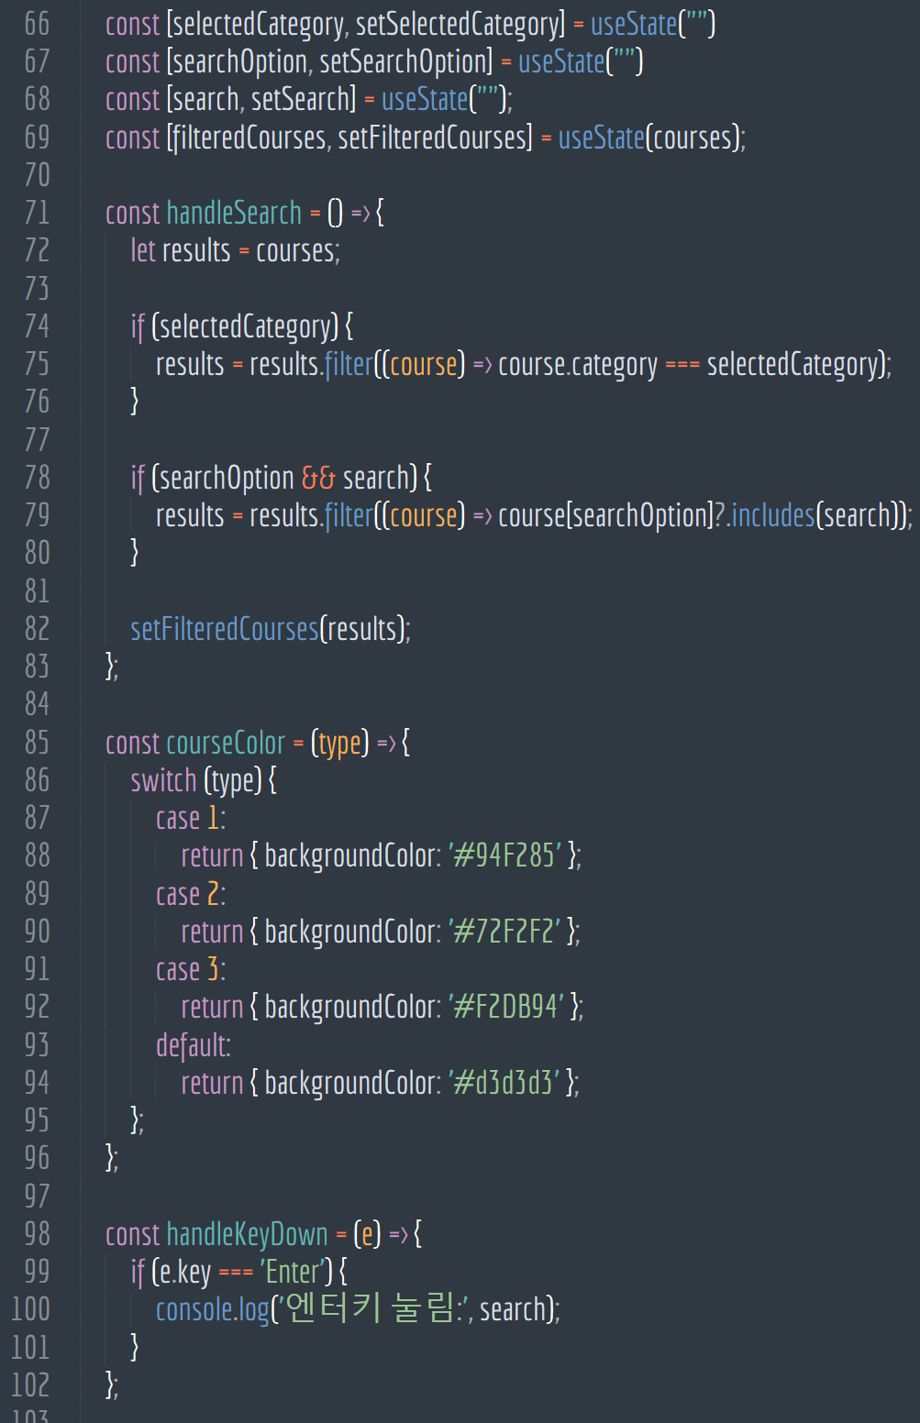
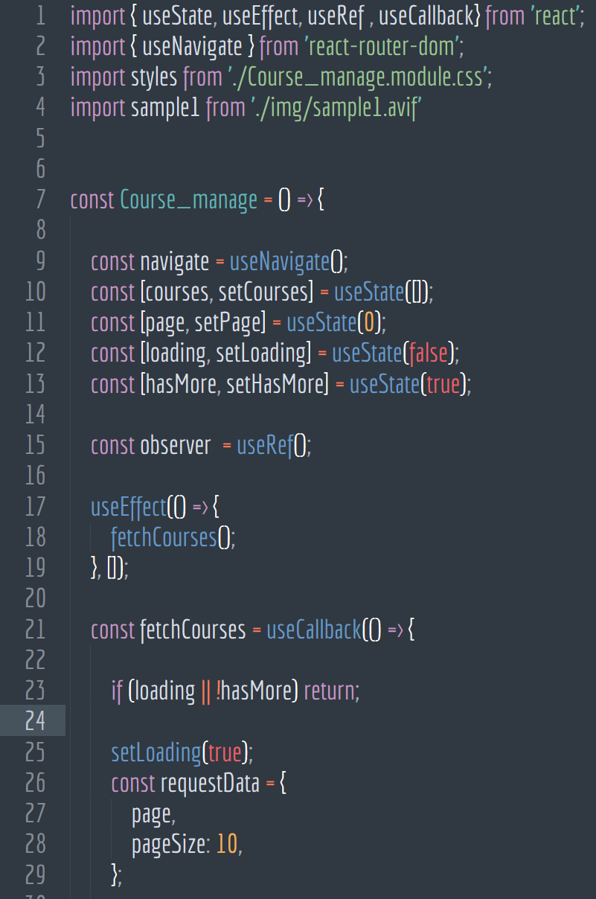
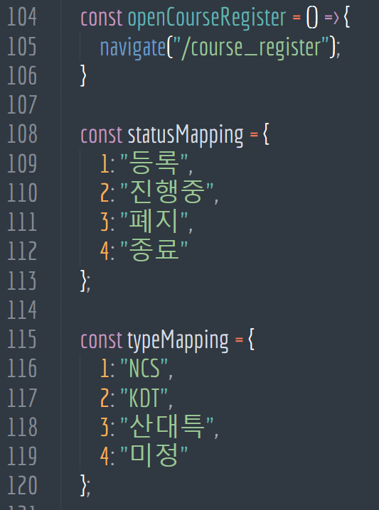
Core Sources_Front-End
Learning Management System
7-9. React - Course

Slide 43

LEARNING
MANAGEMENT
SYSTEM
감사합니다.

